Slide 1
Writing Simple Shell Scripts

Slide 2
A shell script is a group of commands, functions, variables, or just about anything else you can use from a shell.
You can create your own shell scripts to automate the tasks that you need to do regularly.

Slide 3
greeting.sh
1
#!/bin/bash
2
#a Simple shell Script Example
3
#a Function
4
function say_hello()
5
{
6
echo "Enter Your Name,Please. :"
7
read name
8
echo "Hello $name"
9
}
10
echo "Programme Starts Here....."
11
say_hello
12
echo "Programme Ends."

Slide 4
Understanding Shell Scripts
Executing and debugging shell scripts
The filename is used as an argument to the shell (as in bash myscript).
The shell script may also have the name of the interpreter placed in the first line of the script preceded by #! (as in #!/bin/bash) and have the execute bit of the file containing the script set (using chmod +x filename).
You can use set -x near the beginning of the script to display each command that is executed or launch your scripts using $ bash -x myscript

Slide 5
Understanding shell variables
The name of a variable can contain only letters (a to z or A to Z), numbers ( 0 to 9) or the underscore character ( _)
Variable names within shell scripts are case sensitive and can be defined in the following manner: NAME=value CITY="Springfield“ PI=3.14159265
To access the value stored in a variable, prefix its name with the dollar sign ($) echo $NAME
curly braces are used when the value of the parameter needs to be placed next to other text without a space. echo ${city}abc
Variables can contain the output of a command or command sequence. MYDATE=$(date) MACHINE=`uname -n` NUM_FILES=$(/bin/ls | wc -l)
Variables can also contain the value of other variables. BALANCE="$CurBalance"

Slide 6
Single quotes:
Enclosing characters in single quotation marks (‘) holds onto the literal value of each character within the quotes.
Double quotes:
Double quotes are similar to single quotes except that it allows the shell to interpret dollar sign ($), backtick(`), backslash(\) and exclamation mark(!).
test=10
echo "$test"
echo ‘$test'
echo '$HOME * `date`'
echo ″$HOME * `date`
echo $HOME * `date`

Slide 7
Special shell positional parameters
positional parameters or command-line arguments $0, $1, $2, $3. . .$n. $0 is special, and it is assigned the name used to invoke your script; the others are assigned the values of the parameters passed on the command line in the order they appeared.
$# how many parameters your script was given
The $@ variable holds all of the arguments entered at the command line
$? receives the exit status of the last command executed

Slide 8
Reading in parameters
read [-p prompt] [name ...] [name2 ...]
#!/bin/bash
read -p "Type in an adjective, noun and verb (past tense): " adj1 noun1 verb1
echo "He sighed and $verb1 to the elixir. Then he ate the $adj1 $noun1."

Slide 9
Parameter expansion in bash
${var:-value}: If variable is unset or empty, expand this to value.
$ THIS="Example"
$ THIS=${THIS:-"Not Set"}
$ THAT=${THAT:-"Not Set"}
$ echo $THIS
Example
$ echo $THAT
Not Set

Slide 10
${var#pattern}: Chop the shortest match for pattern from the front of var’s value.
${var##pattern}: Chop the longest match for pattern from the front of var’s value.
${var%pattern}: Chop the shortest match for pattern from the end of var’s value.
${var%%pattern}: Chop the longest match for pattern from the end of var’s value.
MYFILENAME=/home/digby/myfile.txt: Sets the value of MYFILENAME
FILE=${MYFILENAME##*/} : FILE becomes myfile.txt
DIR=${MYFILENAME%/*} : DIR becomes /home/digby
NAME=${FILE%.*} : NAME becomes myfile
EXTENSION=${FILE##*.} : EXTENSION becomes txt

Slide 11
Performing arithmetic in shell scripts
Bash uses untyped variables, meaning it normally treats variables as strings of text, but youcan change them on the fly if you want it to.
declare - Declare variables and give them attributes.
Integer arithmetic can be performed using the built-in let command or through the external expr or bc commands.
BIGNUM=1024
let RESULT=$BIGNUM/16
RESULT=`expr $BIGNUM / 16`
RESULT=`echo "$BIGNUM / 16" | bc`
let foo=$RANDOM; echo $foo

Slide 12
Another way to grow a variable incrementally is to use $(())
$ I=0
$ echo "The value of I after increment is $((++I))"
The value of I after increment is 1
$ echo "The value of I before and after increment is $((I++)) and $I"
The value of I before and after increment is 1 and 2

Slide 13
Using programming constructs in shell scripts
The ″if. . .then″ statements
if commands
then <commands> fi
if commands
then <commands> elif commands then <different commands> else <other commands> fi
if commands
then <commands> else <other commands> fi

Slide 14
if commands; then
commands
[elif commands; then
commands...]
[else
commands]
fi
#!/bin/bash
#another example script of if
echo "Input a directory,please!"
read dir_name
if cd $dir_name > /dev/null 2>&1 ;then
echo "enter directory:$dir_name succeed"
else
echo "enter directory:$dir_name failded"
fi

Slide 15
STRING="Friday"
if [ $STRING = "Friday" ] ; then
echo "WhooHoo. Friday."
else
echo "Will Friday ever get here?"
fi
The square brackets ( [ ] ) in the if statement above are actually a reference to the command test. test EXPRESSION [ EXPRESSION ] [[ EXPRESSION ]]
There must be a space between the opening and closing brackets
There must be space before and after the conditional operator (=, ==, <= etc).

Slide 16
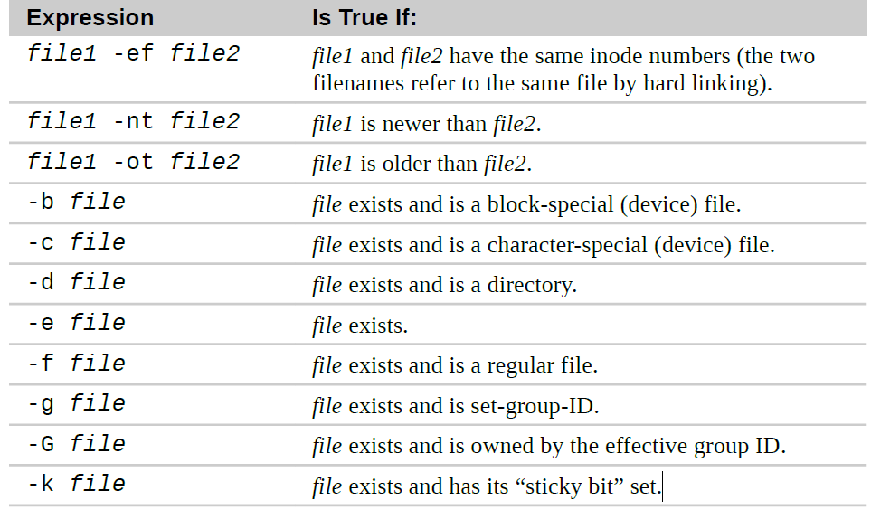
File Expressions

Slide 17
File Expressions
[ -f fname ] | fname 存在且是普通文件时，返回真 ( 即返回 0 )
[ -L fname ] | fname 存在且是链接文件时，返回真
[ -d fname ] | fname 存在且是一个目录时，返回真
[ -e fname ] | fname（文件或目录）存在时，返回真
[ -s fname ] | fname 存在且大小大于 0 时，返回真
[ -r fname ] | fname（文件或目录）存在且可读时，返回真
[ -w fname ] | fname（文件或目录）存在且可写时，返回真
[ -x fname ] | fname（文件或目录）存在且可执行时，返回真

Slide 18
String Expressions
[ -z string ] | 如果字符串string长度为0，返回真
[ -n string ] | 如果字符串string长度不为0，返回真
[ str1 = str2 ] | 两字符串相等（也可使用 == ）返回真
[ str1 != str2 ] | 两字符串不等返回真

Slide 19
Integer Expressions
[ int1 -eq int2 ] | int1 等于 int2 返回真
[ int1 -ne int2 ] | int1 不等于 int2 返回真
[ int1 -gt int2 ] | int1 大于 int2 返回真
[ int1 -ge int2 ] | int1 大于或等于 int2 返回真
[ int1 -lt int2 ] | int1 小于 int2 返回真
[ int1 -le int2 ] | int1 小于或等于 int2 返回真

Slide 20
Combining Expressions
[ expr1 -a expr2 ] | 逻辑与，都为真时，结果为真
[ expr1 -o expr2 ] | 逻辑或，有一个为真时，结果为真
[ ! expr ] | 逻辑非

Slide 21
VARIABLE=1
if [ $VARIABLE -eq 1 ] ; then
echo "The variable is 1"
fi
STRING="Friday"
if [ $STRING = "Friday" ] ; then
echo "WhooHoo. Friday."
else
echo "Will Friday ever get here?"
fi
STRING="FRIDAY"
if [ "$STRING" != "Monday" ] ; then
echo "At least it's not Monday"
fi
filename="$HOME"
if [ -f "$filename" ] ; then
echo "$filename is a regular file"
elif [ -d "$filename" ] ; then
echo "$filename is a directory"
else
echo "I have no idea what $filename is"
fi

Slide 22
# [ test ] || action
# Perform simple single command if test is false
dirname="/tmp/testdir"
[ -d "$dirname" ] || mkdir "$dirname"
# [ test ] && {action}
# Perform simple single action if test is true
[ $# -ge 3 ] && echo "There are at least 3 command line arguments."
# dirname=mydirectory
[ -e $dirname ] && echo $dirname already exists || mkdir $dirname

Slide 23
#!/bin/bash
myhost=centos1.ls-al.me
if ping -c1 -w2 $myhost &>/dev/null
then
echo "$myhost is UP."
else
echo "$myhost is DOWN."
fi

Slide 24
#!/bin/bash
## filename: decide_file_type.sh
[ $# -ne 1 ] && echo "Usage: $0 <filename>" ; exit 1
file=$1
if [ -d $file ]
then echo "$file is a directory"
elif [ -f $file ]
then
if [ -r $file -a -w $file -a -x $file ] ; then
# if [[ -r $file && -w $file && -x $file ]] ; then
echo “You have (rwx) permissioon on $file."
fi
else
echo "$file is neither a file nor a directory."
fi

Slide 25
if [[ "$INT" =~ ^-?[0-9]+$ ]]; then
if [[ INT -ge MIN_VAL && INT -le MAX_VAL ]]; then
echo "$INT is within $MIN_VAL to $MAX_VAL."
else
echo "$INT is out of range."
fi
else
echo "INT is not an integer." >&2
exit 1
fi

Slide 26
The case command
case expr in # expr 为表达式，关键词 in 不要忘！
pattern1) # 若 expr 与 pattern1 匹配，注意括号
commands1 # 执行语句块 commands1
;; # 跳出 case 结构
pattern2) # 若 expr 与 pattern2 匹配
commands2 # 执行语句块 commands2
;; # 跳出 case 结构 ... ... # 可以有任意多个模式匹配
*) # 若 expr 与上面的模式都不匹配
commands # 执行语句块 commands
;; # 跳出 case 结构 esac # case 语句必须以 esac 终止

Slide 27
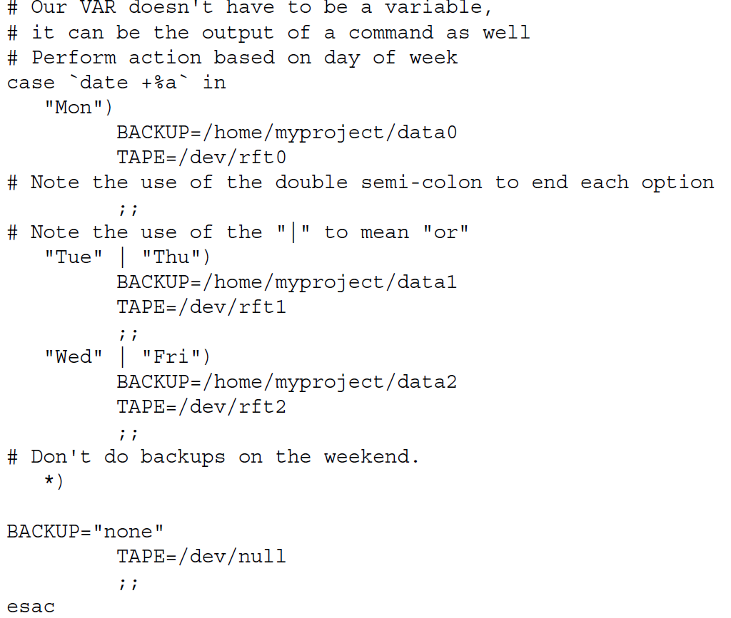

Slide 28
The ″for. . .do″ loop
for variable in list
# 每一次循环，依次把列表 list 中的一个值赋给循环变量
do # 循环体开始的标志
commands # 循环变量每取一次值，循环体就执行一遍
done # 循环结束的标志，返回循环顶部
The list is normally:
Strings
Numbers
Command line arguments
File names
Linux command output

Slide 29
for NAME in John Paul Ringo George ; do
echo $NAME is my favorite Beatle
done
for NUMBER in 0 1 2 3 4 5 6 7 8 9
do
echo The number is $NUMBER
done
for number in {1..10}
for number in {0..100..10}
for fn in /etc/[abcd]*.conf ; do
echo $fn
done
for FILE in `/bin/ls`
do
echo $FILE
done

Slide 30
C syntax
LIMIT=10
# Double parentheses, and no $ on LIMIT even though it's a variable!
for ((a=1; a <= LIMIT ; a++)) ; do
echo "$a"
done

Slide 31
## $@ expands to the positional parameters, starting from one. ##
for i in $@
do
echo "Script arg is $i"
done
#!/bin/sh
for nvar in $*
do
echo "Parameter contains: $nvar"
done

Slide 32
Shift
while [ -n "$1" ]
do
echo "Parameters(\$$count) is:$1"
let count=$count+1
shift
done

Slide 33
#!/bin/bash
## filename: addusers_foreach.sh
for x in {1..50}
do
useradd user${x}
echo "centos"|passwd --stdin user${x}
chage -d 0 user${x}
done

Slide 34
The ″while. . .do″ and ″until. . .do″ loops
while expr # 执行 expr
do # 若expr的退出状态为0，进入循环，否则退出while
commands # 循环体
done # 循环结束标志，返回循环顶部
until expr # 执行 expr
do # 若expr的退出状态非0，进入循环，否则退出until
commands # 循环体
done # 循环结束标志，返回循环顶部

Slide 35
#!/bin/bash
x=1
while [ $x -le 5 ]
do
echo "Welcome $x times"
x=$(( $x + 1 ))
done
#!/bin/bash
num=1
until [ $num -gt 10 ]; do
echo $(($num * 3))
num=$(($num+1))
done

Slide 36
Using Break and Continue in bash loops
for ((i=1;i<=10;i++)); do
echo $i
if [ $i -eq 3 ]; then
break
fi
done
#!/bin/bash
for ((i=0;i<=10;i++)); do
if [ $(($i % 2)) -ne 1 ]; then
continue
fi
echo $i
done

Slide 37
read a text file line-by-line
while IFS= read -r line
do
command1 on $line
command2 on $line
..
....
commandN
done < "/path/to/filename"
IFS is used to set field separator (default is while space). The -r option to read command disables backslash escaping (e.g., \n, \t). T

Slide 38
#!/bin/bash
## filename: while--read_file.sh
file=/etc/resolv.conf
while IFS= read -r line
do
# echo line is stored in $line
echo $line
done < "$file"
while IFS=: read -r user enpass uid gid desc home shell
do
# only display if UID >= 500
[ $uid -ge 500 ] && echo "User $user ($uid) assigned \"$home\" home directory with $shell shell."
done < /etc/passwd

Slide 39
#!/bin/bash
## filename: while-rename_filename.sh
DIR=“.“ # 当前目录
find $DIR -type f | while read file; do
# using POSIX class [:space:] to find space in the filename
if [[ "$file" = *[[:space:]]* ]]; then
# substitute space with "_" character (rename the filename)
mv "$file" $(echo $file | tr ' ' '_')
fi
done
# 找出当前目录下包含空格的文件名，将空格替换为下划线

Slide 40
#!/bin/bash
## filename: until-host_online_to_ssh.sh
read -p "Enter IP Address:" ipadd
echo $ipadd
until ping -c 1 $ipadd &> /dev/null
do
sleep 60
done
ssh $ipadd

Slide 41
#!/bin/bash
## filename: until-user_online_to_write.sh
username=$1
if [ $# -lt 1 ] ; then
echo "Usage: `basename $0` <username> [<message>]"
exit 1
fi
if grep "^$username:" /etc/passwd > /dev/null ; then :
else
echo "$username is not a user on this system."
exit 2
fi
until who|grep "$username" > /dev/null ; do
echo "$username is not logged on."
sleep 600
done
shift ; msg=$*
[[ X"$msg" == "X" ]] && msg="Hello, $username"
echo "$msg" | write $username

Slide 42
Shell Functions
shell functions are“mini-scripts” that are located inside other scripts
Shell functions have two syntactic forms. First, the more formal form:
function name {
commands
return
}
name () {
commands
return
}

Slide 43
#!/bin/bash
function fun1(){
}
......
funciton funn(){
}
...........
.
.
.
.
1 #!/bin/bash
2
3 # Shell function demo
4
5 function step2 {
6 echo "Step 2"
7 return
8 }
9
10 # Main program starts here
11
12 echo "Step 1“
13 step2
14 echo "Step 3"

Slide 44
#!/bin/bash
## filename: pp_and_function.sh
echo "===Print positional parameters in main :"
echo "$0: $*"
pp1(){
echo 'f1--Print $* parameters in fun1 :' ; echo "$0: $*"
}
pp2(){
echo 'f2--Print $* parameters in fun1 :' ; echo "$0: $*"
pp1 1st 2nd 3th 4th 5th 6th 7th 8th 9th
echo 'f2--Print $* parameters in fun1 :' ; echo "$0: $*"
}
pp1 1 2 3 4 5 6 7 8 9
echo "===Print positional parameters in main :"
echo "$0: $*"
pp2 I II III IV V VI VII VIII IX
./pp_and_function.sh a b c d e f g h i

Slide 45
Translate or delete characters (tr) 替换
The tr command is a character-based translator that can be used to replace one character or set of characters with another or to remove a character from a line of text.
The tr command has the following syntax: tr [options] charset1 [charset2]
大小写转换
$ FOO="Mixed UPpEr aNd LoWeR cAsE"
$ echo $FOO | tr [A-Z] [a-z]

Slide 46
# 空格替换成分号
echo “Text has too many spaces” | tr -s ” ” “;”
ext;has;too;many;spaces
echo “Phone number is 123456789” | tr -cd [:digit:]
123456789
for file in * ; do f=`echo $file | tr [:blank:] [_]` [ "$file" = "$f" ] || mv -i -- "$file" "$f"
done

Slide 47
The stream editor (sed)
The sed command is a simple scriptable editor, so it can perform only simple edits, such as removing lines that have text matching a certain pattern, replacing one pattern of characters with another, and so on.
With sed you can do all of the following:
Select text
Substitute text
Add lines to text
Delete lines from text
Modify (or preserve) an original file

Slide 48
sed Syntax sed OPTIONS... [SCRIPT] [INPUTFILE...]
$ sed -n '/home/p' /etc/passwd
$ sed 's/Mac/Linux/g' somefile.txt > fixed_file.txt
$ cat somefile.txt | sed 's/Mac/Linux/g' > fixed_file.txt
$ cat somefile.txt | sed 's/ *$//' > fixed_file.txt

Slide 49
#!/bin/bash
# (@)/ph
# A very simple telephone list
# Type "ph new name number" to add to the list, or
# just type "ph name" to get a phone number
PHONELIST=~/.phonelist.txt
# If no command line parameters ($#), there
# is a problem, so ask what they're talking about.
if [ $# -lt 1 ] ; then
echo "Whose phone number did you want? "
exit 1
fi
# Did you want to add a new phone number?
if [ $1 = "new" ] ; then
shift echo $* >> $PHONELIST
echo $* added to database
exit 0
fi
# Nope. But does the file have anything in it yet?
# This might be our first time using it, after all.
if [ ! -s $PHONELIST ] ; then
echo "No names in the phone list yet! "
exit 1
else
grep -i -q "$*" $PHONELIST # Quietly search the file
if [ $? -ne 0 ] ; then # Did we find anything?
echo "Sorry, that name was not found in the phone list"
exit 1
else
grep -i "$*" $PHONELIST
fi
fi
exit 0

Slide 50
#!/bin/bash
# (@)/my_backup
# A very simple backup script
#
# Change the TAPE device to match your system.
# Check /var/log/messages to determine your tape device.
# You may also need to add scsi-tape support to your kernel.
TAPE=/dev/rft0 # 磁带
# Rewind the tape device $TAPE
mt $TAPE rew
# Get a list of home directories
HOMES=`grep /home /etc/passwd | cut -f6 -d‘:‘` # 竖着截出第六个字段
# Back up the data in those directories
tar cvf $TAPE $HOMES
# Rewind and eject the tape.
mt $TAPE rewoffl

